Slide 1
Deep Learning Fundamentals
Day 2 Training Session — Basics to Intermediate

Slide 2

What is Deep Learning?
Deep Learning is a subfield of Machine Learning based on Artificial Neural Networks.
It mimics the human brain’s way of learning from data.
Can handle large volumes of data and learn complex patterns.
Popular in areas like image recognition, speech processing, natural language understanding.
Example:
Google Photos automatically tagging people in pictures.

Slide 3
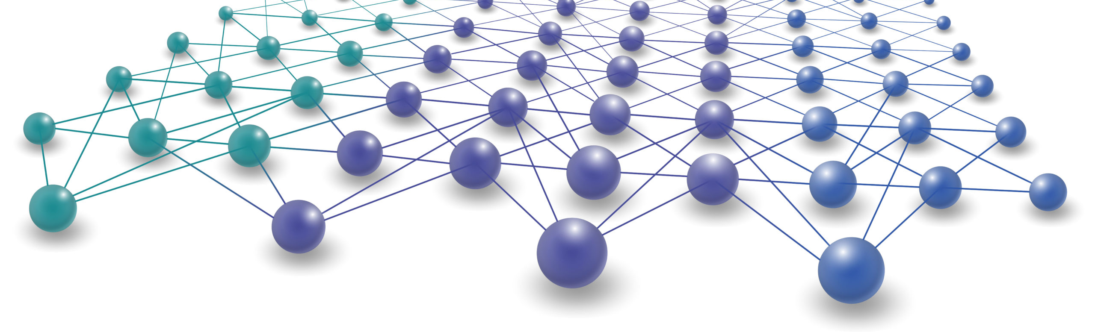
Why Deep Learning is Needed?
Traditional ML struggles with unstructured data like images, audio, video, and text.
Manual feature extraction is tedious and limiting.
Deep Learning automatically extracts features and learns from raw data.
Outperforms conventional ML when data is huge and complex.
Example:
Voice assistants like Alexa or Siri understand spoken commands.

Slide 4
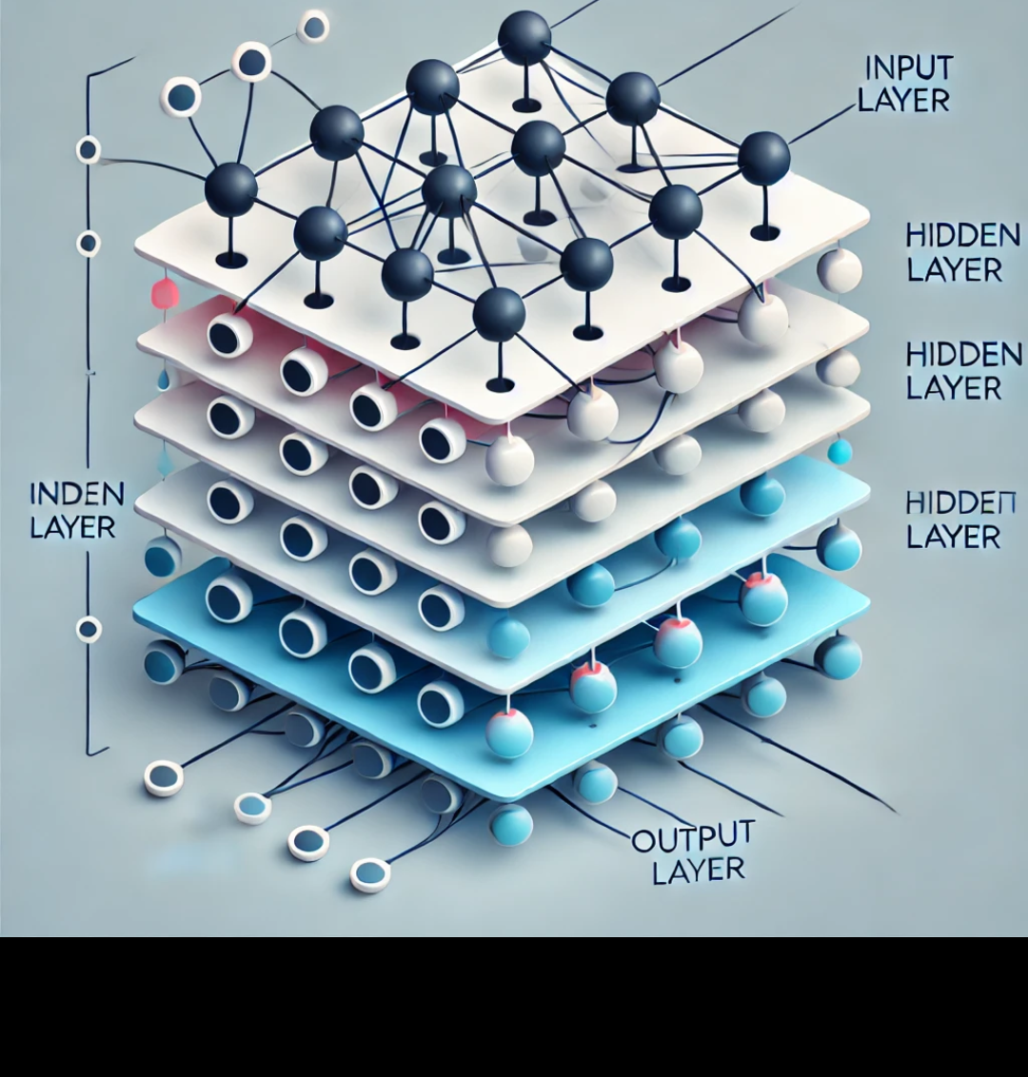
Introduction to Artificial Neural Networks (ANN)
Inspired by the biological neurons in the human brain.
An ANN is made up of:
Input layer
Hidden layers
Output layer
Each layer has nodes (neurons) connected by weights.
Example:
Predicting house prices based on size, location, and number of rooms.

Slide 5
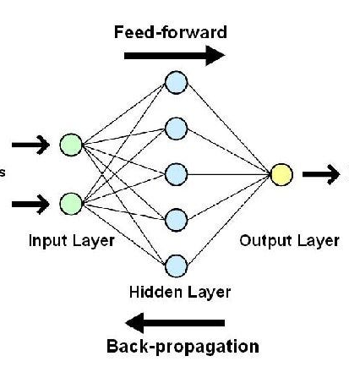
Structure of a Neural Network
Input Layer: Takes raw input features.
Hidden Layers: Process inputs, apply activation functions.
Output Layer: Provides final prediction or classification.

Slide 6
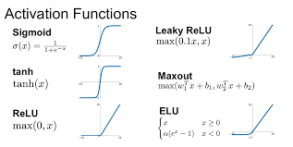
Activation Functions
Introduce non-linearity into the model.
Helps Neural Networks learn complex patterns.
Applied to each neuron’s output.

Slide 7
Types of Activation Functions
Sigmoid: Output between 0 and 1 (good for probabilities).
Tanh: Output between -1 and 1 (centered at 0).
ReLU (Rectified Linear Unit): Commonly used, outputs positive values only.
Example:
Using ReLU in image classification tasks.

Slide 8
Weights, Biases, and Parameters
Weights: Control the strength of connections between neurons.
Biases: Allow shifting the activation function.
Adjusted during training using optimization algorithms.
Example:
A neuron predicting house price increases more if weight on 'Size' feature is high.

Slide 9
Loss (Cost) Function
Measures how far the predicted output is from the actual output.
Common Loss Functions:
MSE (Mean Squared Error) for regression.
Cross-Entropy Loss for classification.
Goal: Minimize this during training.

Slide 10
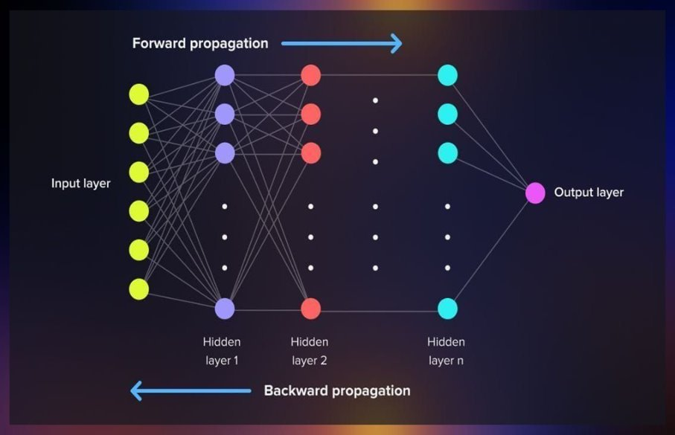
Forward Propagation Process
Data moves from Input → Hidden → Output.
Each layer performs:
Weighted Sum → Apply Activation Function → Pass to next layer.

Slide 11
Back Propagation Process
Adjusts weights and biases by calculating errors.
Uses Gradient Descent to minimize loss.
Process:
Calculate error at the output.
Propagate error back to earlier layers.
Update weights accordingly.
Example: After a wrong prediction, backprop corrects model by tweaking weights.

Slide 12
Gradient Descent & Optimization
Algorithm that updates weights to minimize loss.
Moves in the direction of steepest descent (negative gradient).
Types:
Batch Gradient Descent
Stochastic Gradient Descent (SGD)
Adam Optimizer

Slide 13
CNN Basics & Image Prediction Example
CNN (Convolutional Neural Network) is a specialized DL model for images.
Uses:
Convolution Layers
Pooling Layers
Fully Connected Layers
Example:
Classifying images of cats vs dogs.

Slide 14
Deep Learning Workflow
Data Collection
Data Preprocessing
Model Design (ANN, CNN, etc.)
Loss Function Selection
Optimizer Selection
Model Training
Model Evaluation
Model Deployment

Slide 15
Common Challenges
Overfitting
Underfitting
Regularization
Dropout
Epochs and Batch Size tuning

Slide 16
Natural Language Processing (NLP)

Slide 17
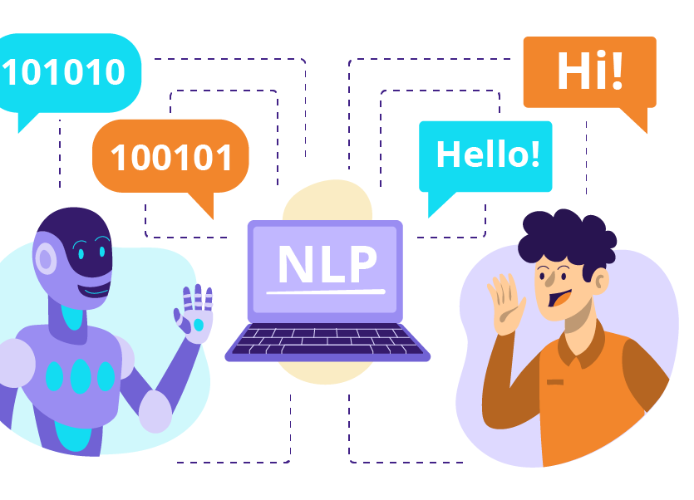
Introduction to Natural Language Processing
Focuses on human language and computers
Applications:
Sentiment Analysis
Machine Translation
Chatbots
Named Entity Recognition
Example: Detecting whether a tweet is positive or negative

Slide 18
Basic NLP Tasks
Tokenization
Stopwords Removal
Stemming & Lemmatization
POS Tagging
Example: “The boy is playing cricket.” POS Tags: The (Det), boy (Noun), is (Verb)

Slide 19
Text Vectorization
Bag of Words (BoW): Example: I love football I love cricket Vocabulary: ['I', 'love', 'football', 'cricket'] Vectors: [1, 1, 1, 0] → I love football [1, 1, 0, 1] → I love cricket

Slide 20
Text Vectorization
TF-IDF(Term Frequency - Inverse Document Frequency)
Word Embeddings (Word2Vec, GloVe)

Slide 21
Sentiment Analysis
Identifies positive, negative, or neutral sentiment
Example: “The product was amazing!” → Positive “Worst experience ever.” → Negative

Slide 22
Named Entity Recognition (NER)
Extracts names, places, organizations, dates from text Example: “Sachin Tendulkar was born in Mumbai”
Person: Sachin Tendulkar
Location: Mumbai

Slide 23
Language Modeling
Predicts the next word in a sentence
Example: “I would like to have a…”
Options: tea, coffee, pizza

Slide 24
Recent Advances: Transformers & BERT
Transformers: Process word sequences with attention mechanisms
BERT: Understands sentence context from both sides Example: “He went to the bank to withdraw money”
BERT knows bank = financial institution, not riverbank

Slide 25
Thank You
Yogeshkumar R
yogeshkumarr@virtusa.com

